Slide 1
USA Performance
Release 51: What’s New
August 13, 2025
OFFICIAL USE NOTICE: This material is intended exclusively for use by USA Performance Customers and is not to be distributed without approval from the USA Performance Program Office. This communication may contain information that is proprietary, privileged, confidential or otherwise legally exempt from disclosure. If you have received this presentation in error, please notify the USA Performance Program Office immediately and delete all copies of the material.
Notes:
This presentation includes updates from our upcoming release, release 51, scheduled to deploy on August 21st

Slide 2
Agenda
v.51 Deployment- (08/21)
  SL/ST Policy Changes (SP)
  SES Policy Changes
  More Enhancements
  Power BI – Introduction, Access, and Report Preview
Questions
Notes:
Today’s agenda will include a recap of the recently of what will be included in the upcoming release scheduled to deploy on InsertDateHere as well as a look into Release 51 and what’s next.

Slide 3

SL/ST Policy Changes
The SP (SL/ST) template and plan settings are updated to conform to OPM Memorandum “New Senior Professional Performance Appraisal System and Plan.”
Historical plans are unaffected by the new policy. All plans created after Release 51 will automatically adopt the new SP (SL/ST) settings.

Slide 4
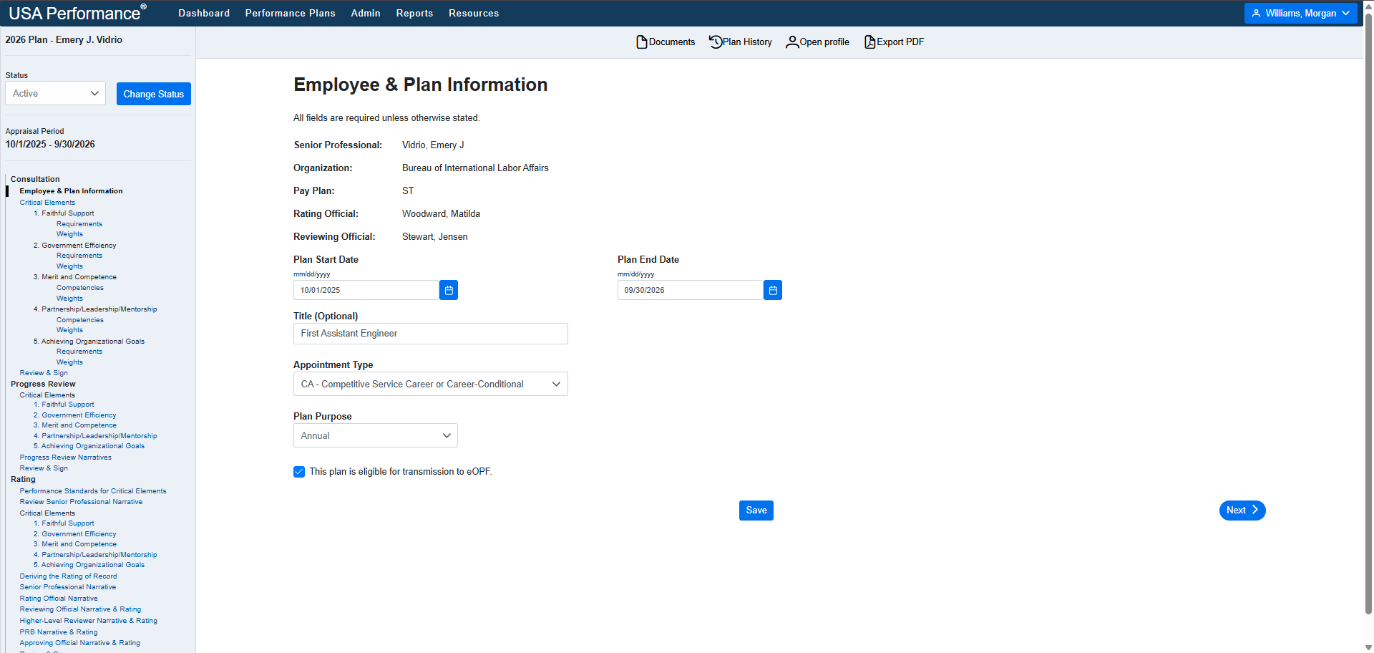
Supervisory Status Removed

Slide 5
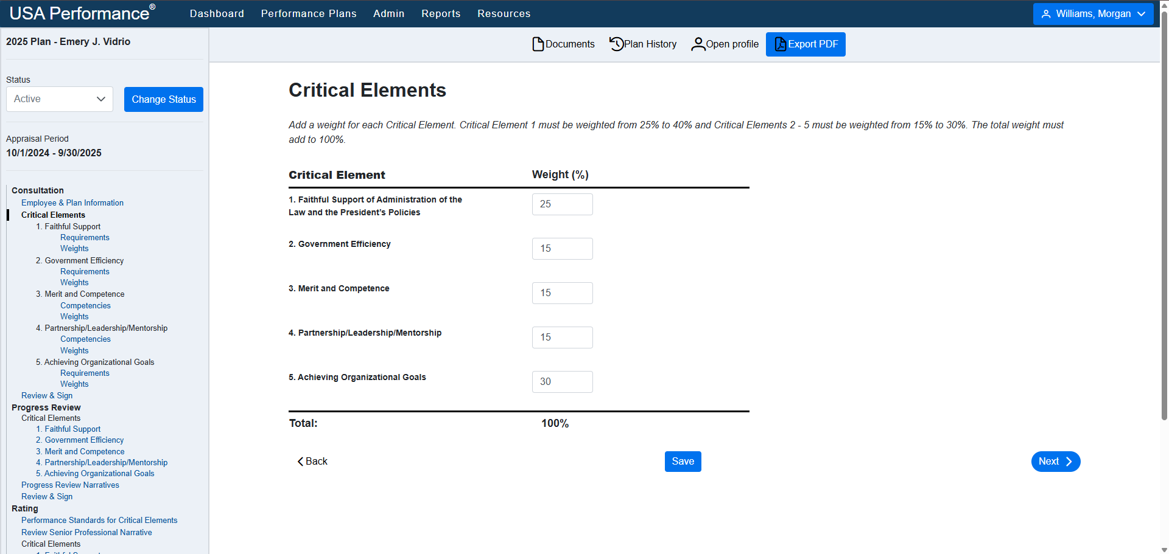
Critical Element Weights (and CE5 is required)

Slide 6
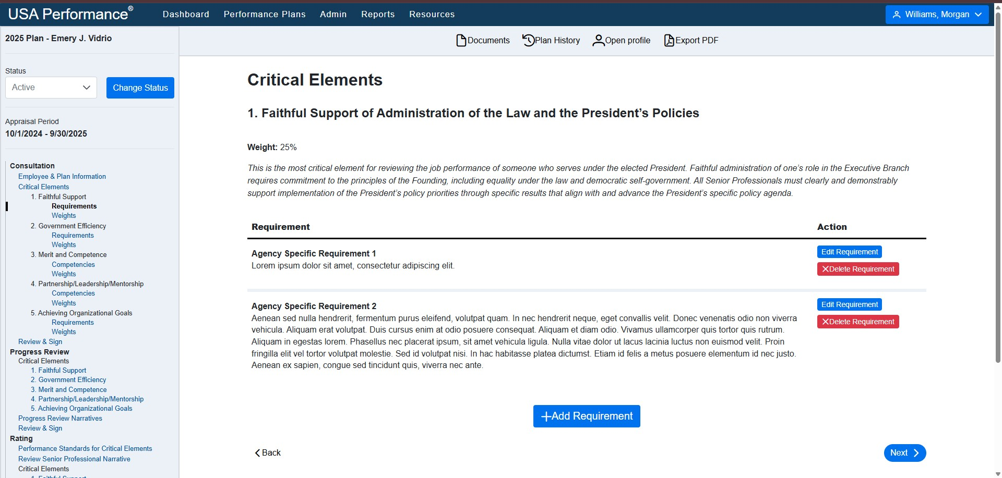
Critical Element 1

Slide 7
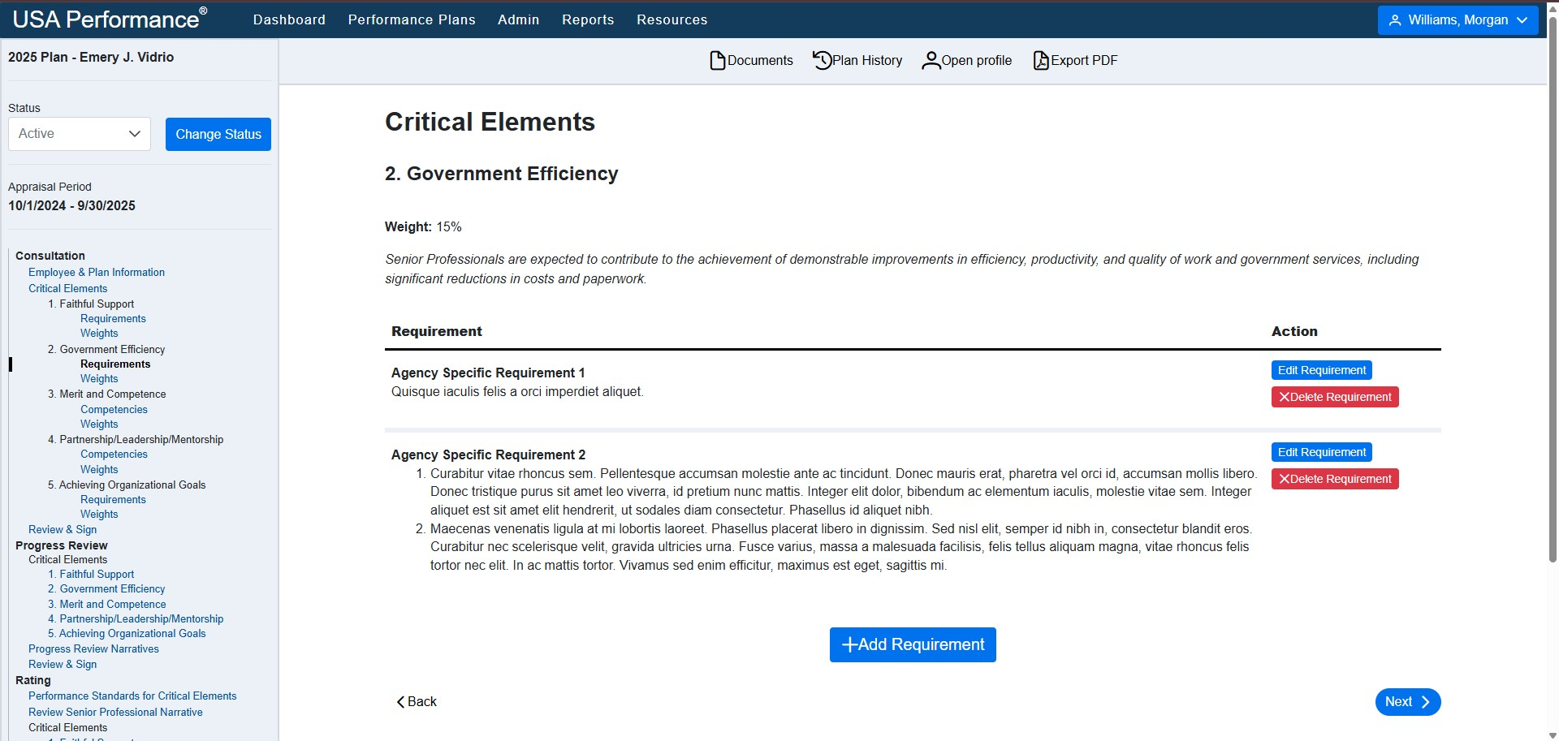
Critical Element 2

Slide 8
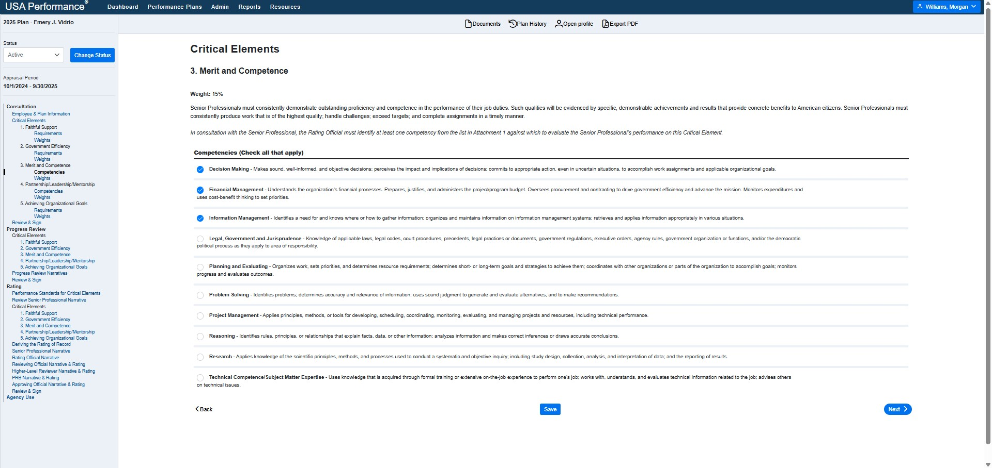
Critical Element 3

Slide 9
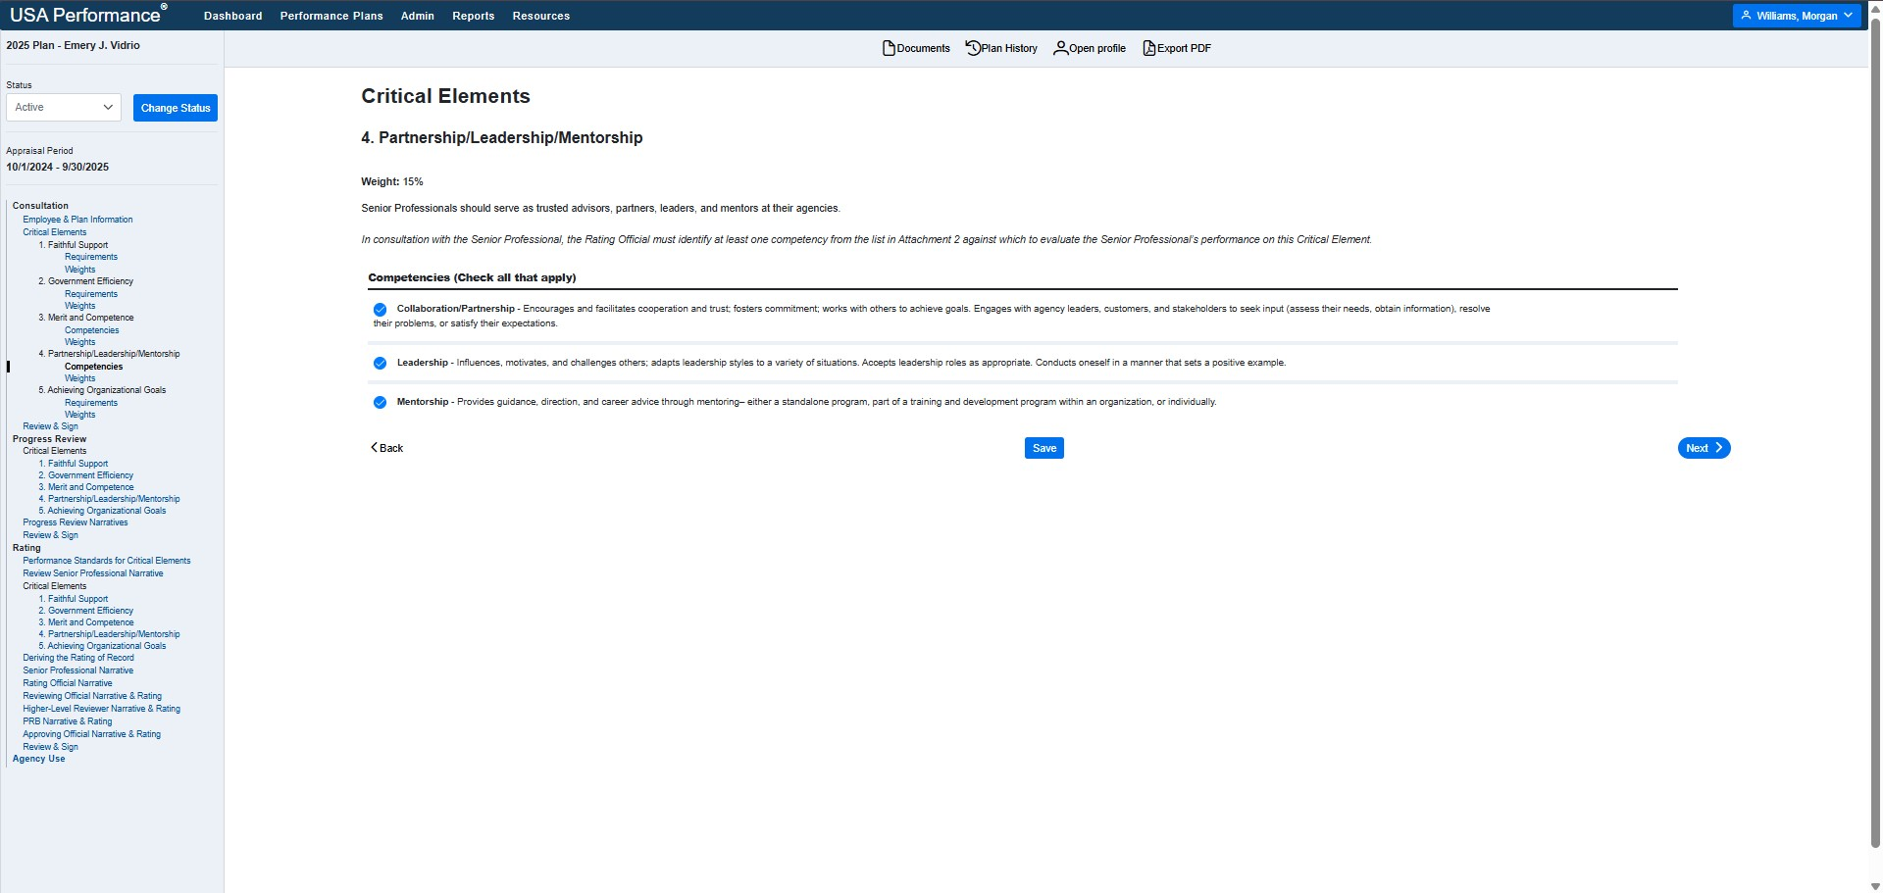
Critical Element 4

Slide 10
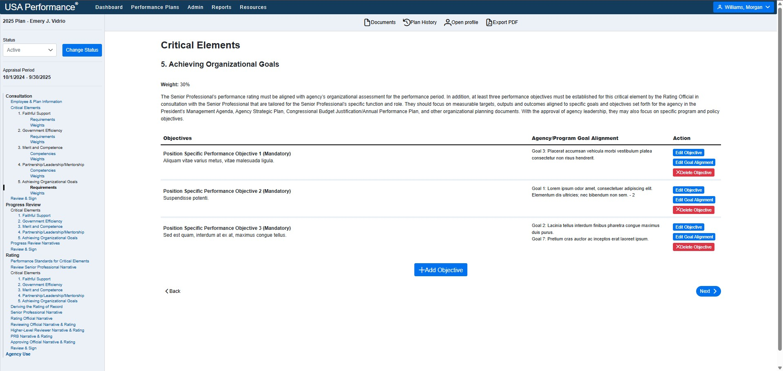
Critical Element 5

Slide 11
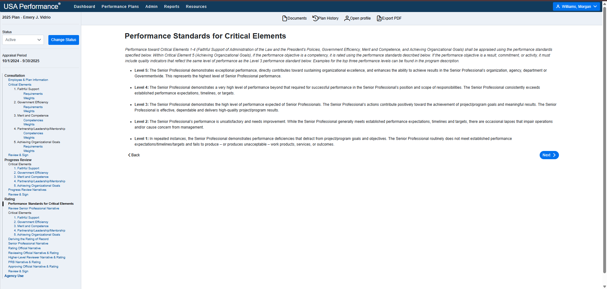
Standard Text

Slide 12
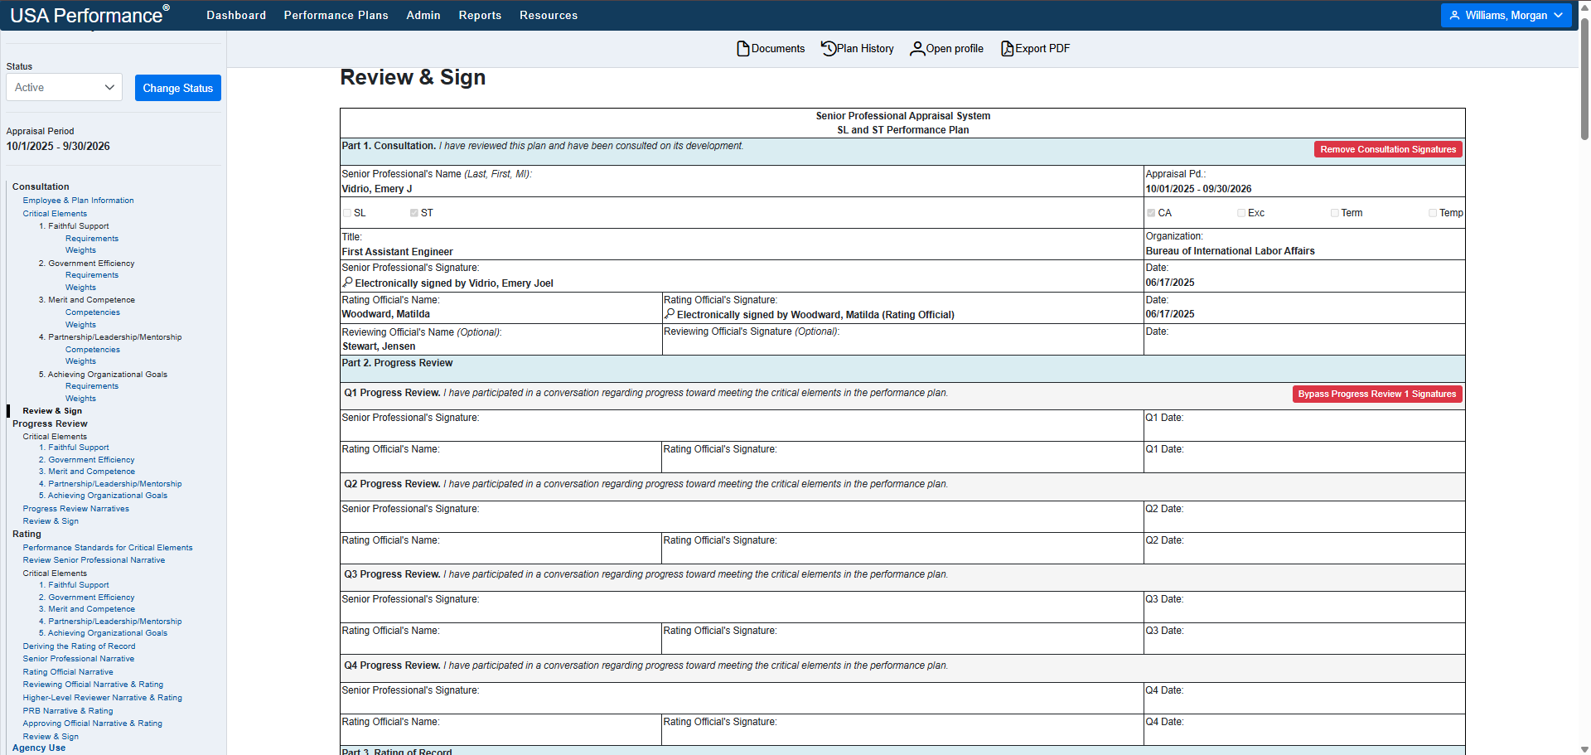
4 Progress Reviews (and Progress Review Bypasses)

Slide 13
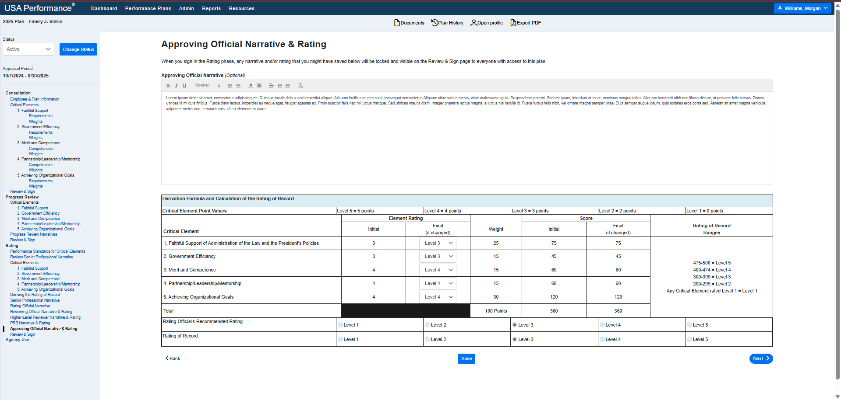
Approving Official Element Ratings

Slide 14

SES Policy Changes
SES template and plan settings are updated to conform to OPM Memo “New Senior Executive Service Performance Appraisal System and Performance Plan, and Guidance on Next Steps for Agencies to Implement Restoring Accountability for Career Senior Executives.”
Historical plans and templates are unaffected by the new policy. All templates created after Release 51, along with plans created from those templates will automatically adopt the new SES settings.
Refer to the Memorandum for specific updates.

Slide 15
Key Plan & System Highlights
4 Progress Reviews
Critical Element Minimums
Critical Element 5 Performance Requirements
Validation and Error Messaging
Verbiage Changes to Plans (Parts 2-7)

Slide 16
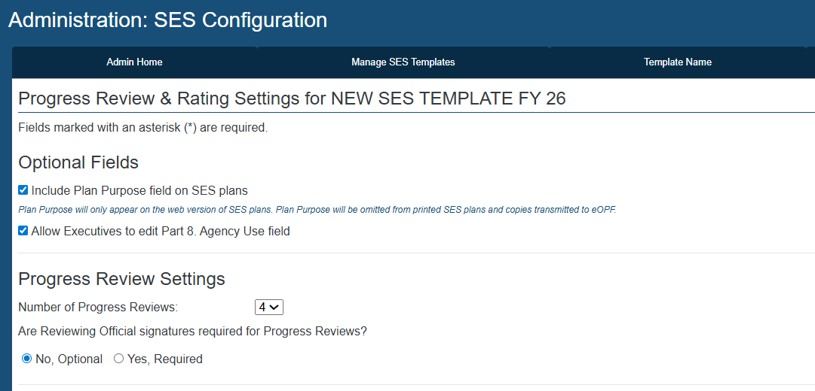
Progress Review Settings (4 Progress Reviews)

Slide 17
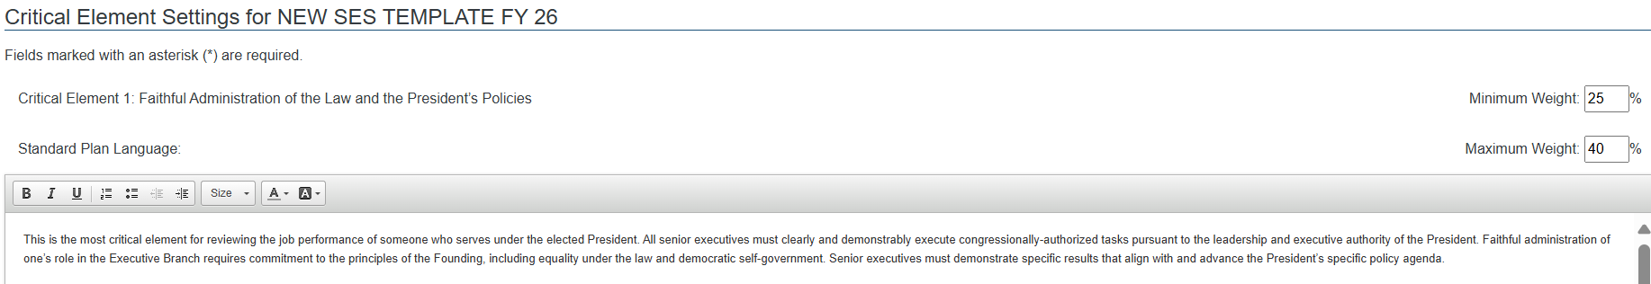
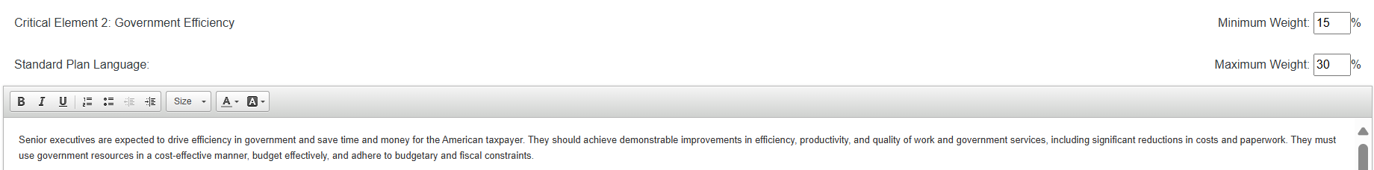
Critical Element Minimum Weights

Slide 18
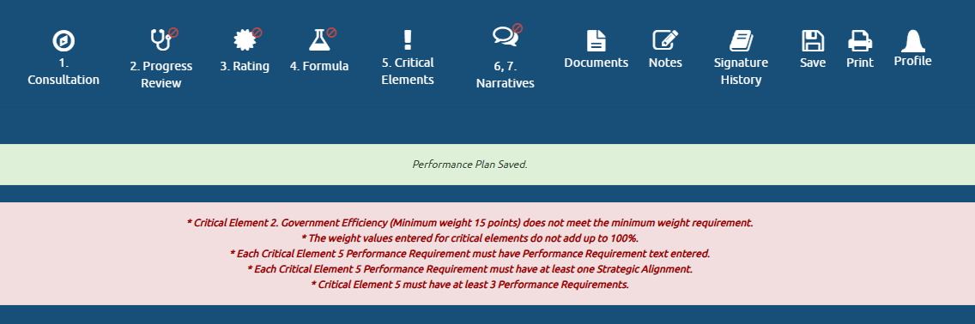
Validation and Error Messaging
Notes:
To ensure agency executives are compliant, we’ve enhanced validation and error messaging that drive users to exactly what needs be addressed in order to save the plans successfully.

Slide 19
Ooo-Ahhh, More Enhancements

Slide 20
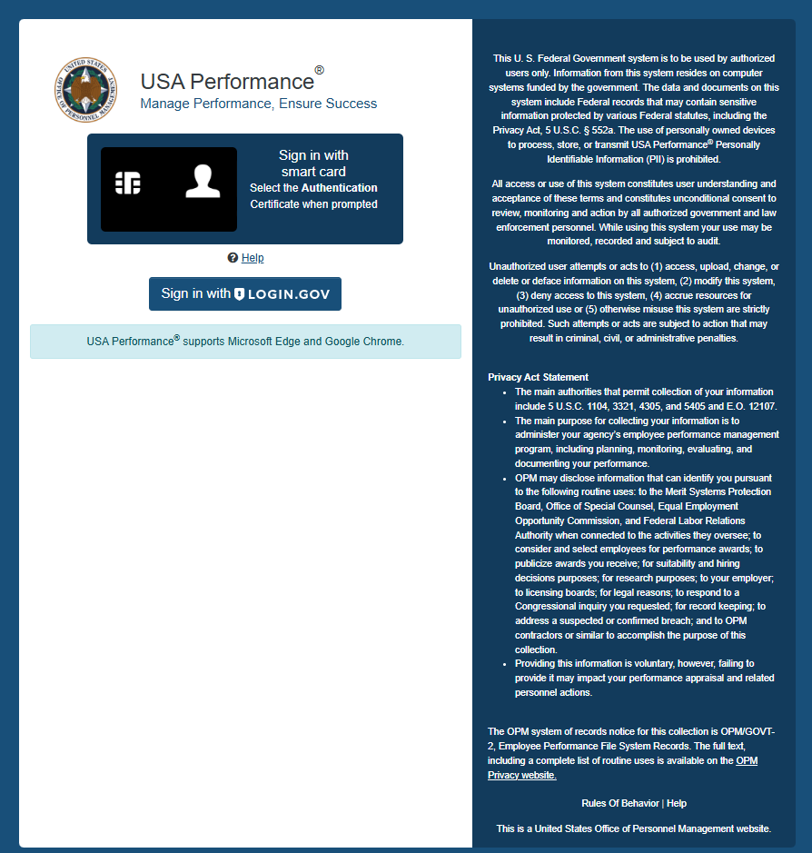
Privacy Act Statement
The login page has been updated to include the USAP Privacy Act Statement (PAS)
Pursuant to 5 U.S.C. §552a (e) (3) agencies are required to provide a PAS to all persons asked to provide personal information, which will go into a system of records

Slide 21
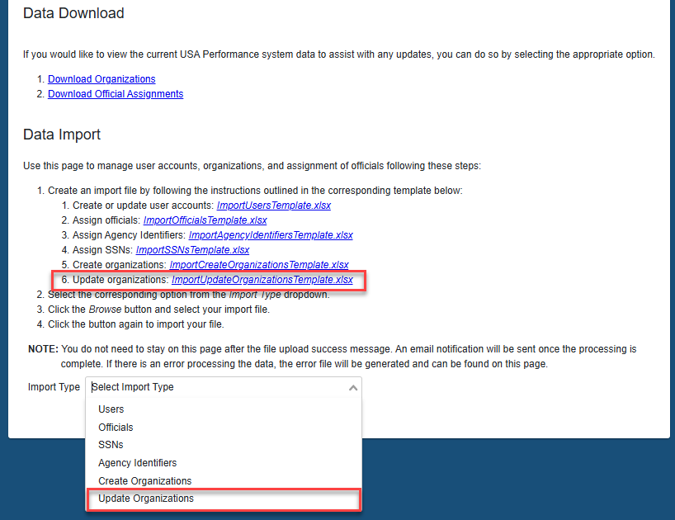
Import Page
Admins are now able to update organizations

Slide 22
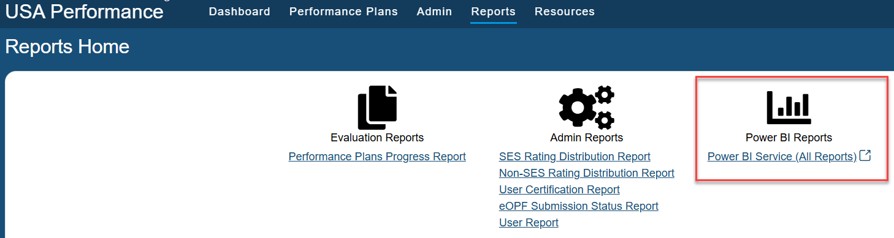
Reports Page
Power BI Report link added (external link)

Slide 23

Additional Updates
Non-SES Supervisory Element Script Creation
GW Pay Plan - Wildland Firefighter (in production)
Performance Enhancements
Backend database updates

Slide 24

Introduction to Power BI
Microsoft Power BI Advantages:
  Cloud-based servicing = fast refresh times
  Wide adoption across multiple platforms
  Interactive reporting (with visualizations)
Notes:
Good afternoon! I’m excited to introduce Power BI as the new reporting tool for USA Performance, bringing a range of advanced reporting features to our users. This transition is part of a larger initiative to move OPM products to the Microsoft Azure cloud environment.
One of Power BI's strengths is its ability to create interactive and dynamic visualizations. Power BI reports use a variety of charts, graphs, and tables to present data in compelling and easy-to-understand views. Interactivity features such as exporting, sorting and filtering, enhance data exploration and analysis.
With our data now stored in the cloud, you can expect faster refresh times, multiple times per day and easy access to a wide variety of interactive reports.

Slide 25
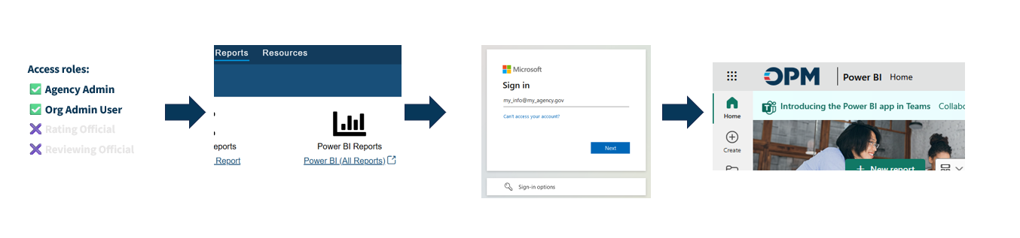
Accessing Power BI for USA Performance
Power BI access via USA Performance® Apps Workspace:
https://www.usaperformance.opm.gov → 🔓 → Reports → Power BI (All Reports) → Apps Workspace → Performance Management App or Performance Ratings App
Notes:
In order to access USA Performance’s Power BI reports as either an agency or org admin, please sign into the usaperformance.opm.gov page, and navigate to the Power BI All Reports hyperlink, under the Power BI Reports icon. If your agency has enabled Certificate Based Authentication, or CBA, you should be able to easily sign in using your email address, where you will be taken to the main Power BI homepage. Once you’ve successfully authenticated into Power BI, you will be brought to the Apps Workspace and can select the Performance Management App or the Performance Ratings App to view the available reports.

Slide 26
Performance Management App Reports
Non-SES/SP Plan Activity and Progress Report (PAPR)
SES Plan Activity and Progress Report (PAPR)
Administrative Profile Report
eOPF Submission Status Report
Performance Review Board (PRB) Report
Notes:
Our reports are organized into two Apps: the Performance Management App and the Performance Ratings App. In Power BI, an App is a collection of related reports and data models that makes it easy to find and access the information you need. Each report is interactive, so you can use filters to view specific data and tailor the results to your interests. This flexibility helps you quickly find the information that matters most to you.
The first App, the Performance Management App, includes several key reports:
Non-SES/SP Plan Activity and Progress Report (PAPR)
SES Plan Activity Progress Report (PAPR)
Administrative Profile Report
eOPF Submission Status Report
Performance Review Board (PRB) Report

Slide 27
Non-SES/SP Plan Activity Progress Report (PAPR)
Overview
Organization Progress
Plans Ending Within 30 Days
Filter by Plan Attributes
Filter by Plan Holder
Notes:
The Non-SES/SP Plan Activity and Progress Report offers insights into the plan progress throughout the rating cycle, including information such as plan end date, rating cycle phase, and individual plan details.
Please note the SES Plan Activity and Progress Report has a similar set of report pages.
I’d like to go into a little more detail on one of these report pages, Organization Progress, for illustrative purposes.
The Organization Progress displays a count of total active plans with a bar chart showing their distribution by phase (Planning, Progress Review, Rating, and Completed).

Slide 28
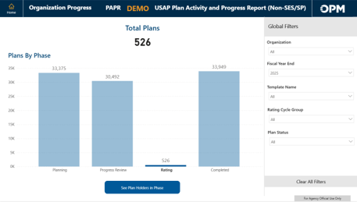
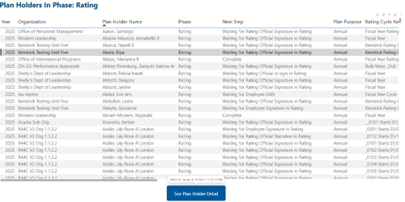
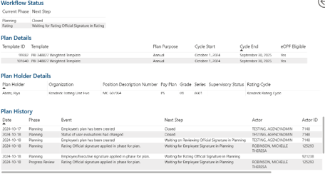
Non-SES/SP PAPR Organization Progress Page
Notes:
The Organization Progress displays a count of total active plans with a bar chart showing their distribution by phase (Planning, Progress Review, Rating, and Completed).
By clicking on any of the vertical bar charts and then clicking on the “See Plan Holders in Phase” card below, allows you to drill down to see a list report, detailing that all the plan holders in that particular phase (in this example, the “Rating” Phase).
By clicking on one of these plan holders in this list report and then clicking on the “See Plan Holder Detail” card below, allows you to see more detail, such as the plan holder’s next step, rating cycle, plan cycle start and end dates, and the entire plan history action items.

Slide 29
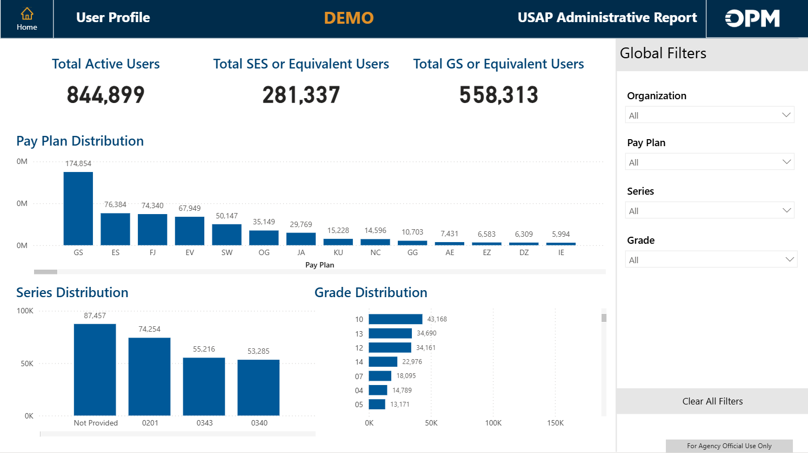
Administrative Profile Report
Overview
User Profile
User Role Distribution
Profile Lockout
2-Week Lockout Warning
SSN or Agency ID Missing
Template/Rating Cycle Needed
RO and RevO - Assignments Needed
Notes:
The Administrative Profile Report provides detailed information on users’ account status, identifies inactive accounts, as well as blank SSN’s. I’d like to focus on the User Profile report page for illustrative purposes.
This report page contains a variety of metrics, including counts of total active users, and a distribution of pay plan, pay series and pay grade across the agency.

Slide 30
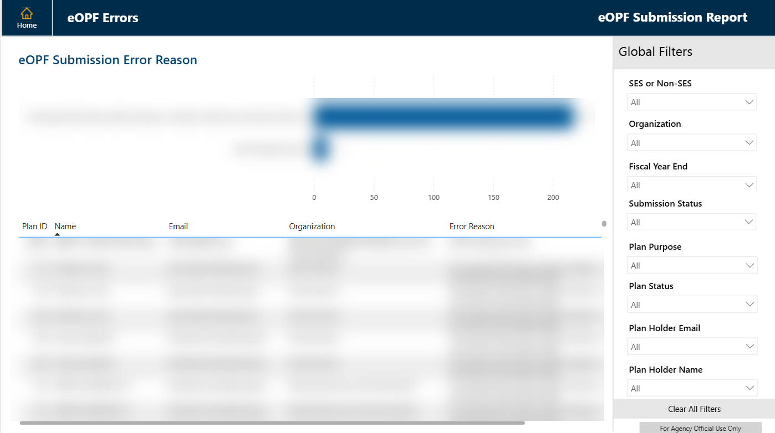
eOPF Submission Status Report
Overview
eOPF Submission Overview
Ready for eOPF Submission
eOPF Submissions Status
eOPF Errors Received
Notes:
The Electronic Official Personnel Folder, or eOPF, Submission Status Report identifies plans that are ready for eOPF transmission, those that have already been submitted, and a detailed look at any errors that occurred.
Let’s take a look at the last report page for illustrative purposes. This report page provides a count of reasons why a plan submission returned an error. There is an Excel-style table list report at the bottom that provides details for those plan holders as well as their error reason.

Slide 31
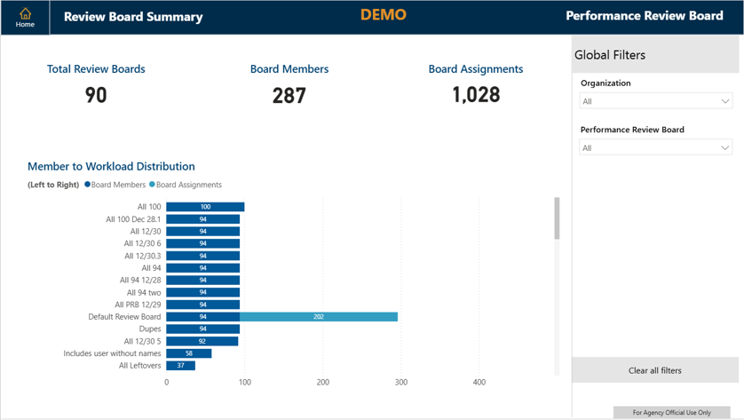
Performance Review Board (PRB) Report
Overview
Review Board Summary
Board Composition and Assignments
Notes:
The Performance Review Board, or PRB, Report provides insight into the current PRB Groups within USA Performance, including the chairs, group members, and their respective assigned workloads.
We will look at the Review Board Summary Report page for illustrative purposes. This report page shows the count of total review boards, board members and board assignments.
The horizontal stacked bar chart visualization at the bottom provides details regarding how many board members and board assignments comprise each Performance Review Board group.

Slide 32
Performance Ratings App Reports
Non-SES/SP Performance Ratings Report
SES Performance Ratings Report
Notes:
The second app, called the Performance Ratings App, includes both Non-SES and SES Ratings Reports. With these reports, agencies can view overall ratings distributions at the agency or subagency level, as well as drill down to see individual ratings for employees and executives. These reports are especially valuable for providing key insights in response to recent Executive Orders and Memos related to Performance Management.

Slide 33
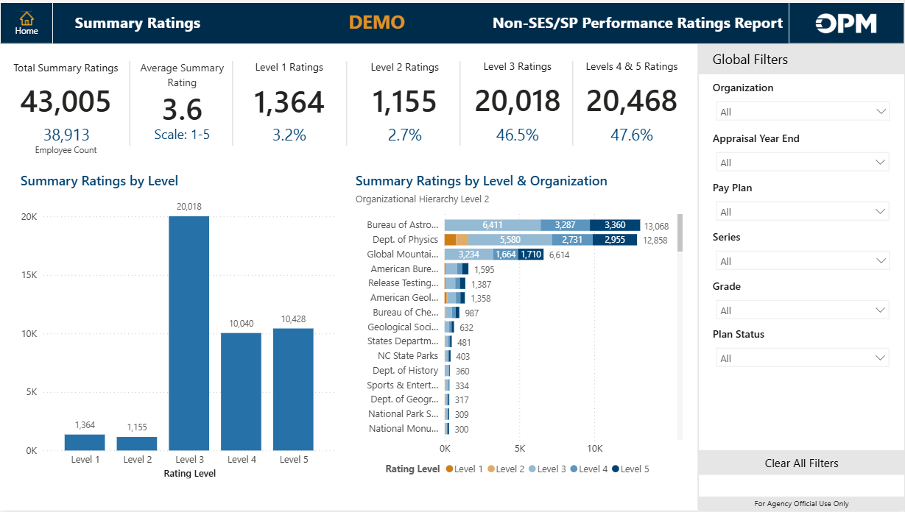
Non-SES/SP Performance Ratings Report
Overview
Summary Ratings
Element Ratings
Employee Plan Lookup
All Ratings
Notes:
The Non-SES/SP Performance Ratings Report provides reporting capabilities on the ratings of GS-equivalent employees.
This report includes the following pages: Overview, Summary Ratings, Element Ratings, Employee Plan Lookup, and All Rating. Here is a preview of the Summary Ratings page, which displays the distribution of ratings by level across the agency. You can also drill down into specific subagencies or components for more detailed insights. The page features clear visual representations of the rating percentages.

Slide 34
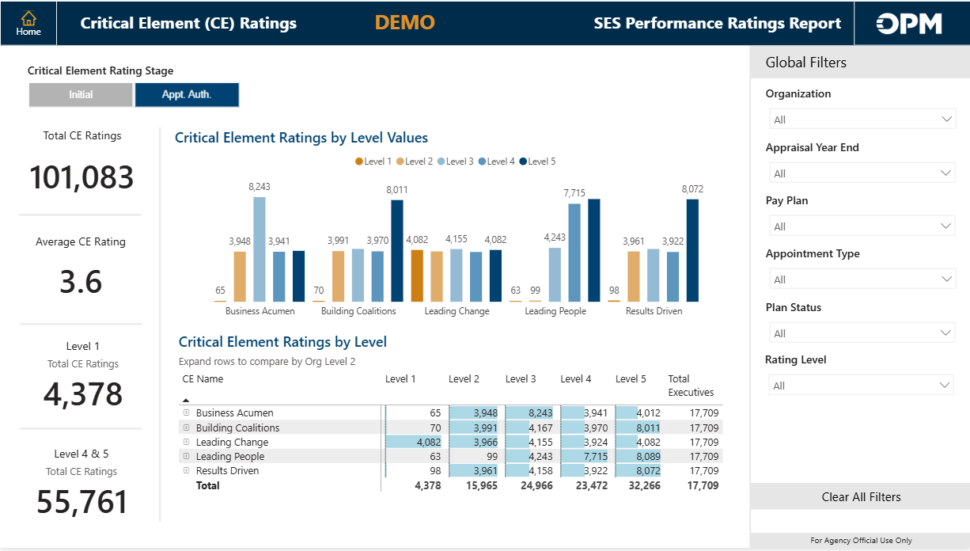
SES Performance Ratings Report
Overview
Summary Ratings
Critical Element Ratings
Executive Plan Lookup
All Ratings
Notes:
The SES Performance Ratings Report provides reporting capabilities on the ratings of senior executives.
This report contains the same pages as the Non-SES version, except for the Critical Element Ratings page. Shown here is a preview of the Critical Elements Ratings report page, which displays the distribution and average of critical elements by level across the agency. You can also filter the data to view specific subagencies and components.

Slide 35

Power BI Training Resources
Power BI Report Consumer Training (recording available)
Power BI Report Overview Guide
FAQ document
Notes:
Several Power BI training resources will be available on the USAP Learning Management System. The Power BI Report Consumer Training offers an overview of Power BI, instructions on how to access the reports, and includes a recorded session. The Power BI Report Overview Guide provides detailed information about the individual reports. Additionally, an FAQ document will be available, addressing common use cases for data in Power BI for USA Performance.

Slide 36
Questions?

Slide 37

Customer Sneak Peak
User Acceptance Testing for Release 51 will be available on August 14!
Contact your Account Manager if you are interested in participating.
Notes:
If you have any questions or would like to participate in testing, please reach out to your Account Manager (AM) for guidance.

Slide 38
Thank you!

