Slide 1
USA Performance
Office Hours - August 2026
Supplemental Slides
OFFICIAL USE NOTICE: This material is intended exclusively for use by USA Performance Customers and is not to be distributed without approval from the USA Performance Program Office. This communication may contain information that is proprietary, privileged, confidential or otherwise legally exempt from disclosure. If you have received this presentation in error, please notify the USA Performance Program Office immediately and delete all copies of the material.

Slide 2
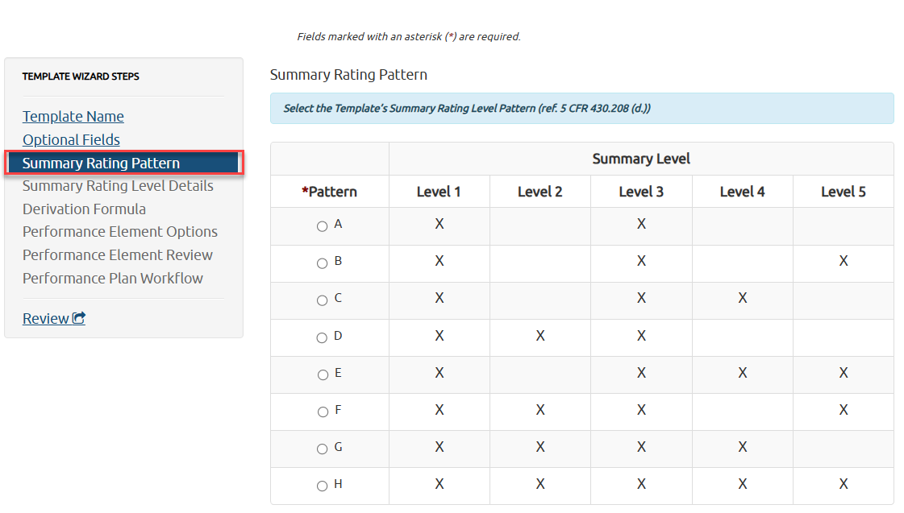
Template Update: Summary Rating Level Change
Removing Level 2
Update Summary Rating Level Pattern in each USAP Template
  Note: This requires an agency policy change.
  Title 5 Pattern Options?
    Options: A (1/3), B (1/3/5),C (1/3/4/5)

Slide 3
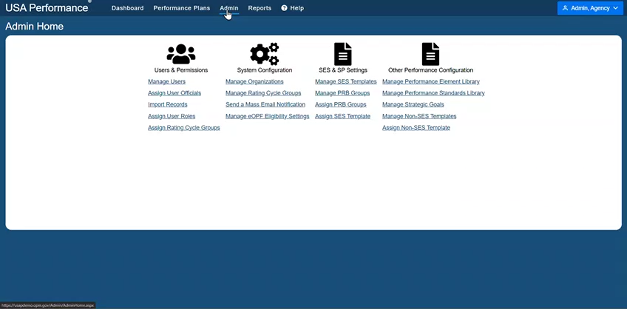
Removing Level 2 from Element Ratings

Slide 4
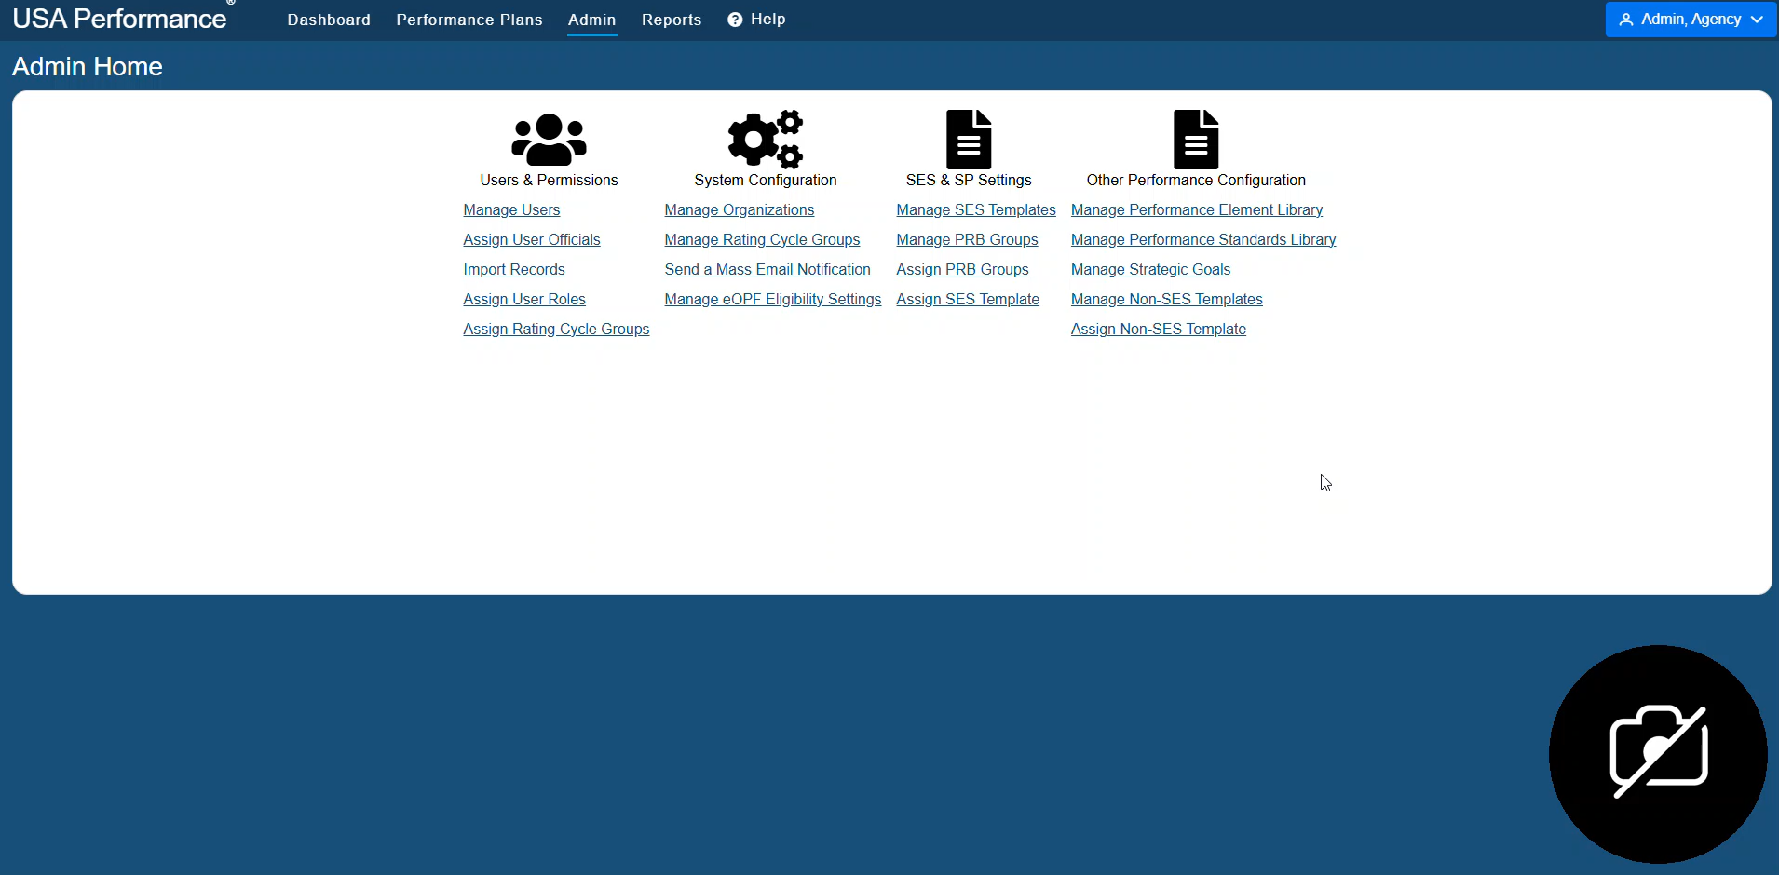
Performance Appraisal Certification Option
USA Performance non-SES Templates allow for a “Performance Appraisal Certification” (PAC)
  PAC allows for an additional review of an appraisal prior to its final completion
  PAC Options:
    No Additional Review is required (default)
    After the Rating Official signs in the Rating Phase
    After the Reviewing Official signs in the Rating Phase
    After the Employee signs in the Rating Phase
Agency determines who to designate as the PAC
  Many agencies set an HR Rep as the PAC
PAC can mass sign appraisals (or bypass signature)
Potential work around for PMO requirement/function
Hover cursor over this picture to enable play button to watch a quick tutorial on how to add the PAC

Slide 5

Providing Performance Standards Language Beyond the Required Level 3
Your agency may need to add standard language for Levels 4 and 5. Navigate to the Admin tab, under Other Performance Configuration, click Manage Performance Standards Library
(Hover cursor over this picture to enable play button to watch a quick tutorial on how to add Standards to the Standards Library)

Slide 6
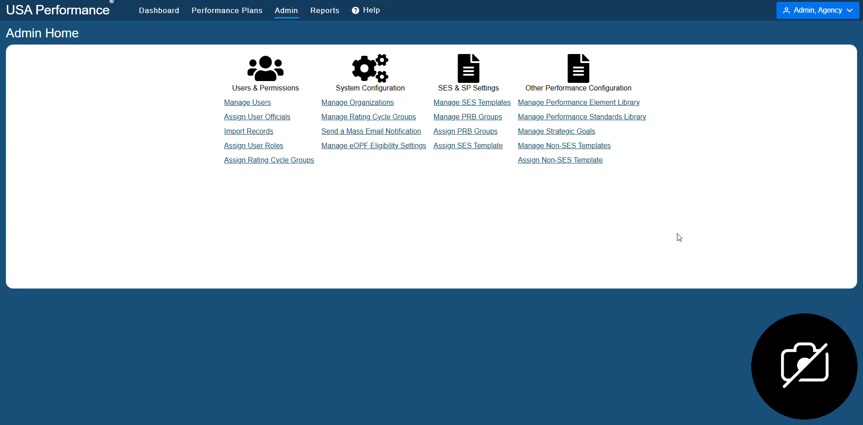

Holding Employees Accountable – Supervisory Element
Friendly reminder…All agencies covered under chapter 43 of title 5, USC, must add this mandatory critical element to each supervisory non-SES/SP plan.
(Hover cursor over this picture to enable play button to watch a quick tutorial on how to add Holding Emp. Acct. Stds. to Standards Library)
(Hover cursor over this picture to enable play button to watch a quick tutorial on how to add Holding Emp. Acct. to Performance Element Library)

